Slide 1
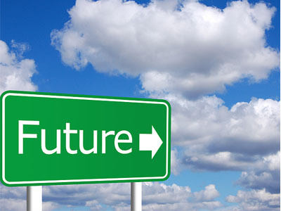
THE FUTURE
*TRANSPORTS
*BUILDINGS
*SHOPPING

Slide 2
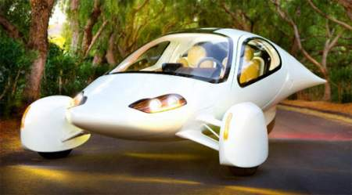
THE TRANSPORTS
THE TRANSPORTS
*The transports will probably go very fast and they can fly.
*They will be very clean and confortable and will be recharged with sunligh.
*And maybe the cars will go without driver and the bus and train too.

Slide 3
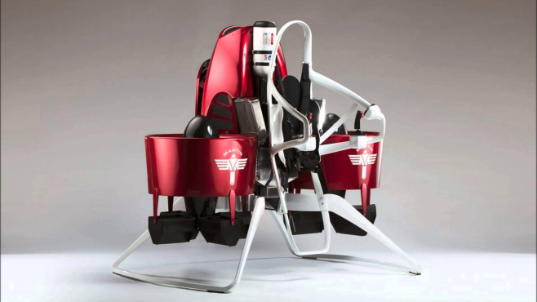
The jetpacks : are backspacks with a propeller and a parachute and its work is for move in small places.
EXAMPLES:

Slide 4
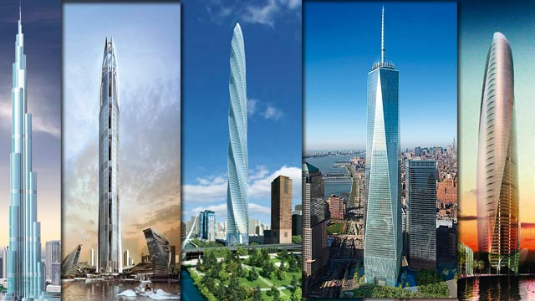
THE BUILDINGS
THE BUILDINGS
*They will be ecological for improve the environment.
*They will probably very strange and high.
*And I imagine that maybe the doors will open with the phone.
Notes:
perfectoooooooooooooooooooooooooooooooooooooooooooooooooo

Slide 5
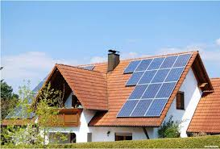
The houses will use solars panels instead of electricity.
EXAMPLES:

Slide 6
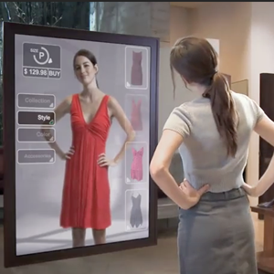
THE SHOPPING
THE SHOPPING
*I imagine that probably the tester will be virtual and the pay will be with the phone.
*And maybe there will be applicationsto to mesure and decorate your house.

Slide 7
THE END
BY : Claudia Pérez Jiménez

